Slide 1
CENG-232 Logic Design
Lecture 2
Boolean Algebra & Logic Gates

Slide 2
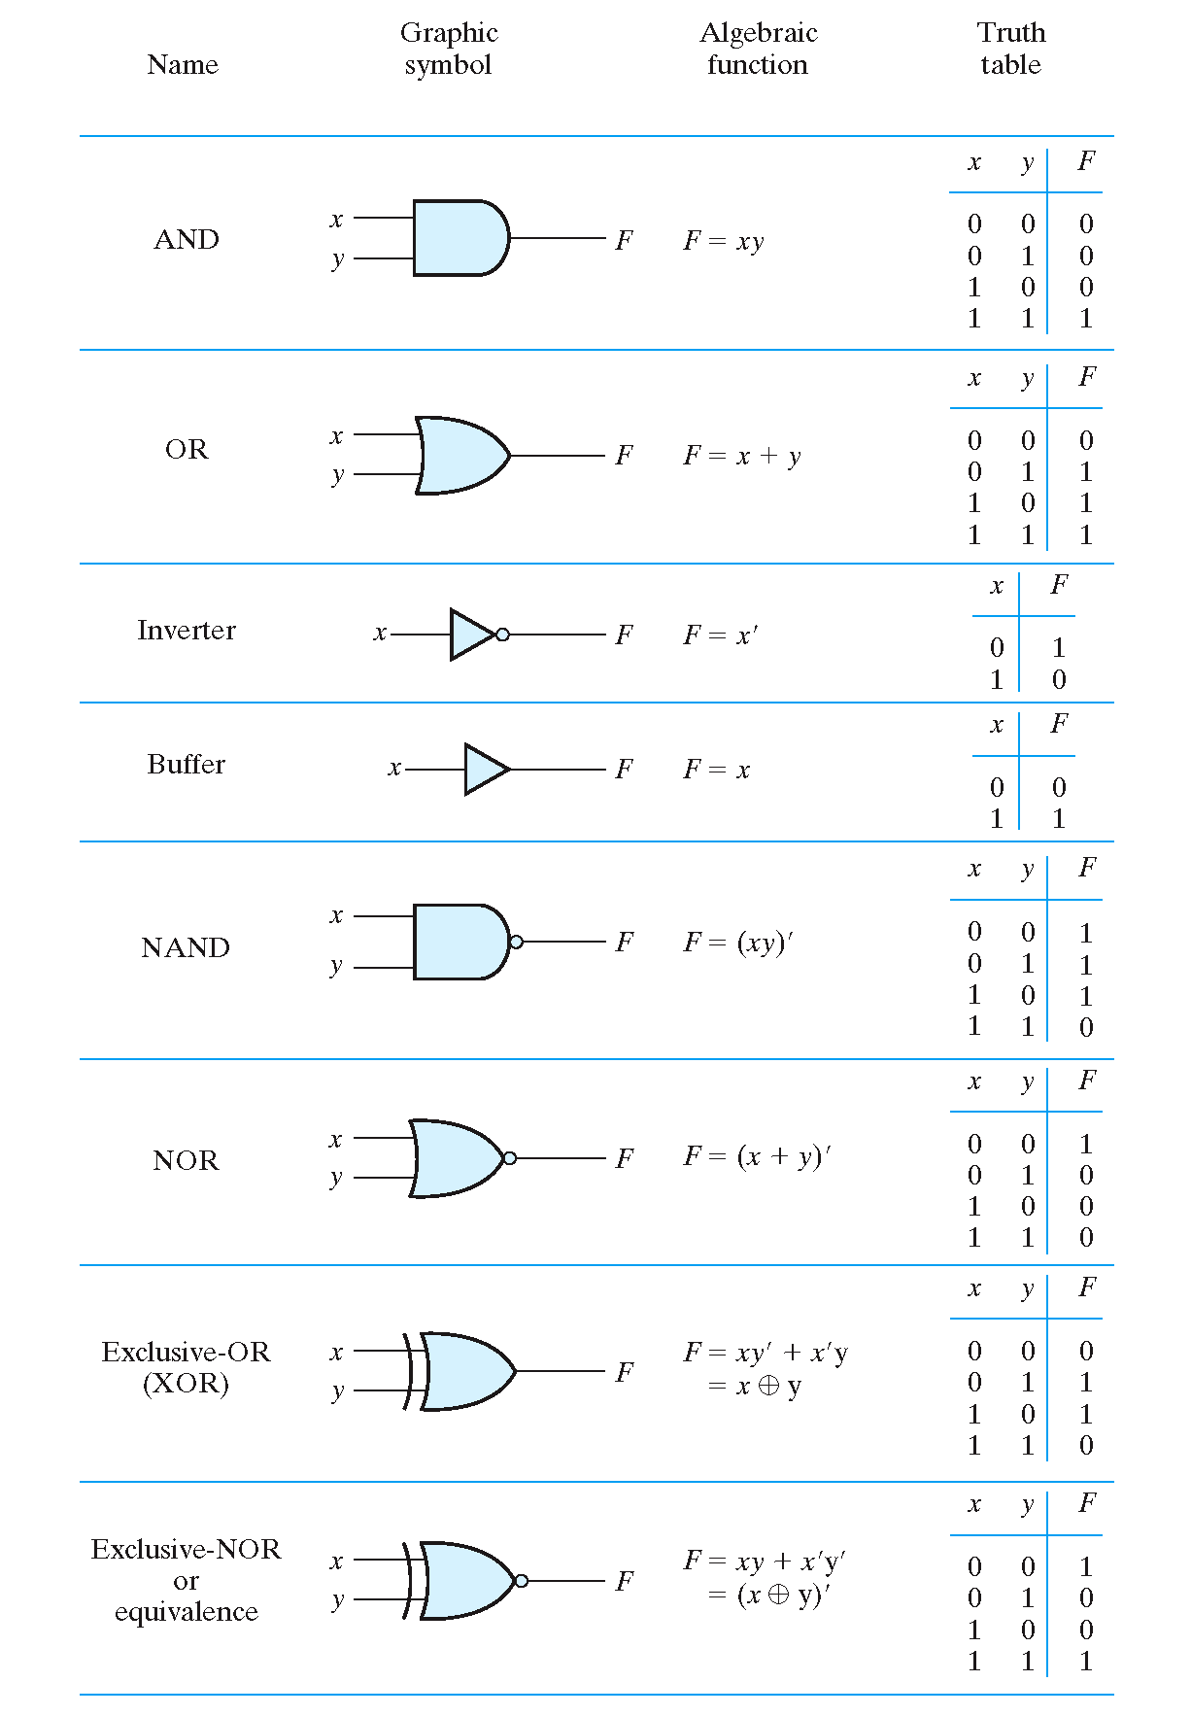

Slide 3
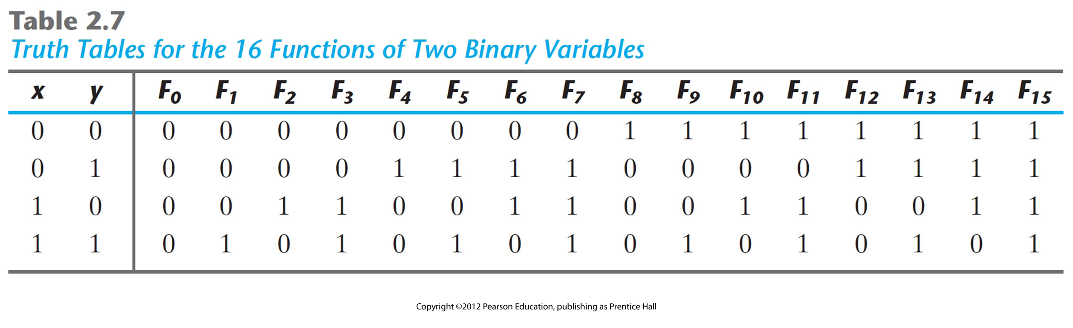
We have seen AND, OR, NOT
How many other logic operations are possible?

Slide 4
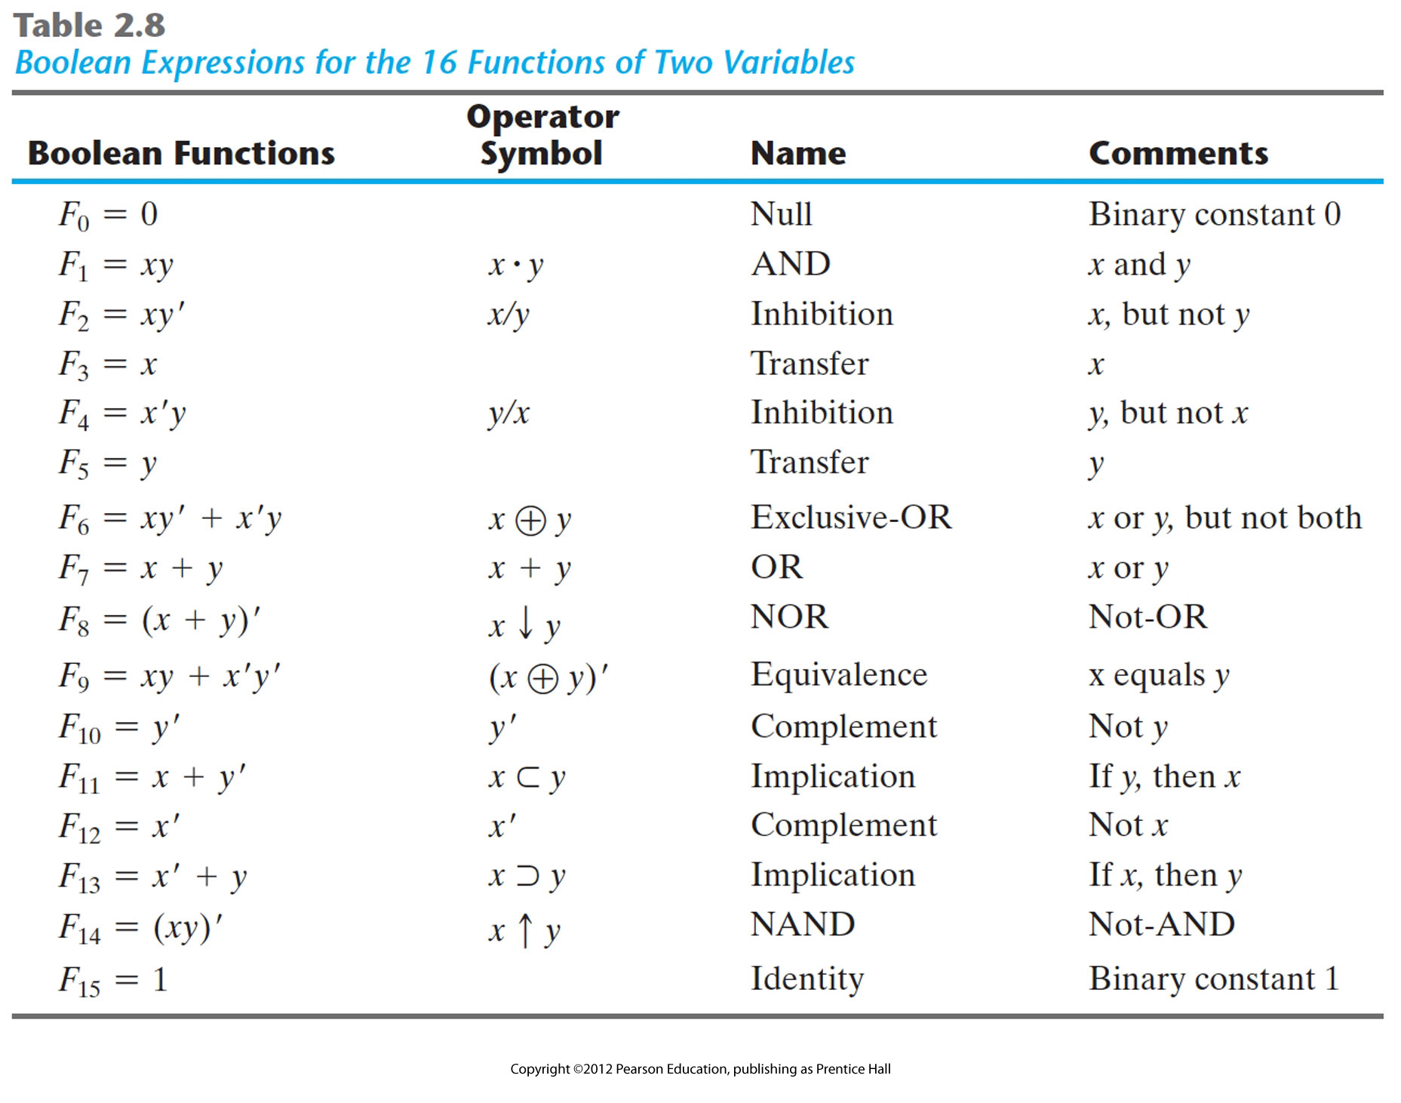

Slide 5
Additional Logic Operations
For two inputs, there are 16 ways we can assign output values
Besides AND and OR, five others are useful
The unary Buffer operation is useful in the real world
X
0
1
Z=X
0
1
1
X
Z=X
X
Z=X

Slide 6
Additional Logic Operations - NAND
NAND (NOT - AND) is the complement of the AND operation
X
0
0
1
1
Y
0
1
0
1
X·Y
1
1
1
0
&

Slide 7
Additional Logic Operations - NOR
NOR (NOT - OR) is the complement of the OR operation
X
0
0
1
1
Y
0
1
0
1
X+Y
1
0
0
0
≥1

Slide 8
Additional Logic Operations - XOR
Exclusive OR is similar to the inclusive OR except output is 0 for 1, 1 inputs
Alternatively the output is 1 when modulo 2 input sum is equal to 1
X
0
0
1
1
Y
0
1
0
1
X+Y
0
1
1
0
=1

Slide 9
Additional Logic Operations - XNOR
Exclusive NOR is the complement of the XOR operation
Alternatively the output is 1 when modulo 2 input sum is not equal to 1
X
0
0
1
1
Y
0
1
0
1
X+Y
1
0
0
1
=1

Slide 10
Minimal Logic Operator Sets
AND, OR, NOT are all that’s needed to express any combinational logic function as switching algebra expression
operators are all that were originally defined
Two other minimal logic operator sets exist
Just NAND gates (a universal gate)
Just NOR gates (a universal gate)
We can demonstrate how just NANDs or NORs can do AND, OR, NOT operations

Slide 11
Minimal Logic Operator Sets
Why do we care?
NAND and NOR gates are easier to fabricate with electronic components
And they are the basic gates used in all IC digital logic families.

Slide 12
NAND as a Minimal Set
X
X’
(X.X)’=X’
(XY)’
X
XY
XY
Y
X’
(X’Y’)’
=X+Y
Y’

Slide 13
NOR as a Minimal Set

Slide 14
Convert from AND-OR to NAND-NAND
An example (from Fig 3.18 in your book). All three circuits below implement the same function.
1.
2. 3.
Similar conversion is possible for OR-AND to NOR-NOR’
Do it yourself!

Slide 15
Odd-Function
XY
Z
=(XY’+X’Y) Z
= (XY’+X’Y) Z’+ (XY’+X’Y)’Z
=XY’Z’+X’YZ’+XY’Z+X’YZ
Remember XOR function
X Y
Outputs 1 when X,Y are different
Consider 3-input XOR:
(X Y) Z= X ( Y Z)= X Y Z
K-Map for 3-input XOR:
00 01 11 10
0 1 1
1 1 1

Slide 16
Odd-Function
=(XY’+X’Y) Z
=(XY’+X’Y) Z’+ (XY’+X’Y)’Z
=XY’Z’+X’YZ’+XY’Z+X’YZ
Remember XOR function
X Y
Outputs 1 when X,Y are different
Consider 3-input XOR:
(X Y) Z= X ( Y Z)= X Y Z

Slide 17
Odd-Function Cont.
Output is ‘1’ when an odd number of inputs are ‘1’.
Why is it important?
Parity bit for even parity in ASCII code will use this function.
For n bits, same structure continues..
A0
A1
A2
Parity bit
A3

Slide 18
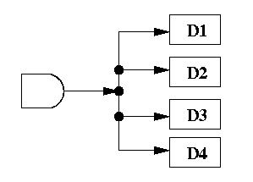
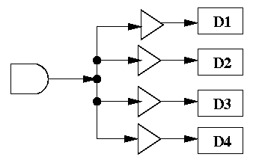
Buffers
Buffers look useless because z=x
We need them for certain practical issues such as:
x
z
The current can decrease if the fan out is large
The current can be boosted to its
original strength.
(Figures from https://www.cs.umd.edu/class/sum2003/cmsc311/Notes/CompOrg/tristate.html)

Slide 19
Three State (or Tri-state) Buffers
IN_H
OUT_H
IN_H
OUT_L
EN_H
EN_L
IN_H
OUT_H
EN_L
IN
X
0
1
EN
0
1
1
OUT
HI-Z
0
1
High-impedance state(like an open circuit)
Same as input

Slide 20
Three State Outputs
Standard logic gate outputs only have two states; high and low
Outputs are effectively either connected to +V or ground (low impedance)
Certain applications require a logic output that we can “turn off” or disable
Output is disconnected (high impedance)
This is the three-state output
May be stand-alone (a buffer) or part of another function output

Slide 21
Three-State Outputs
IN1
EN1
IN2
One of EN1, EN2, EN3 should be 1 at the same time!
Otherwise, the circuit will be burned.
Only one of IN1,IN2, IN3 will be connected to the output.
EN2
IN3
EN3
Three-state buffers are used usually when you want to connect only one of k inputs to a wire

